Slide 1
Eyenet Digital Signage
for Technology Retail Shops
Open. Flexible. Owner-controlled.
Eyenet Vision | May 2026

Slide 2
Open Hardware & No Multi-Sensor Setup Burden
"deploy faster with no complex multi-sensor setup burden, run on everyday open hardware instead of locked camera ecosystems"
• Works with everyday cameras and standard compute hardware
• Supports mixed hardware generations across store estates
• Avoids lock-in to closed camera vendors and proprietary appliance chains
• Simplifies deployment architecture for demographic-aware signage
• Enables staged rollout instead of full-store replacement
• Lower replacement risk when device vendors change strategy
Eyenet Vision | Technology Retail Pitch

Slide 3
Flexible Display Endpoints — Wall to Laptop
"operate signage from big wall screens and entrance LED panels down to single tabletop laptops"
• Big wall displays — hero product narratives and brand campaigns
• Entrance LED panels — dynamic campaign hooks at the door
• Mid-store digital screens — zone-specific promotions
• Counter displays — assisted selling and targeted offers
• Single tabletop laptops — zero-infrastructure endpoint option
• Same campaign logic delivered across all endpoint types
Eyenet Vision | Technology Retail Pitch

Slide 4
No Bulky Booth Lock-In
"remove the operational burden of bulky, rigid booth models"
• Marketing teams no longer trapped in fixed kiosk/booth models
• Campaigns can be changed without infrastructure redesign
• Faster campaign updates without rebuilding physical layouts
• Less physical reconfiguration for new promotions or launches
• Better support for seasonal and launch-driven retail cadence
• Lower capex pressure when scaling to new store zones
Eyenet Vision | Technology Retail Pitch

Slide 5
Web + Mobile Access from Anywhere
"manage campaigns from anywhere using any device via web dashboard and mobile apps"
• Owners, marketing teams, and managers access operations remotely
• Any device supported: desktop, tablet, or smartphone
• Teams stay operational without being tied to in-store control stations
• Campaign uploads, endpoint assignments, and scheduling from any location
• Faster response to floor-level changes or urgent campaign needs
Eyenet Vision | Technology Retail Pitch

Slide 6
Real-Time Campaign Monitoring
"monitor guest engagement in real time and adjust content on the fly"
• Live monitoring of guest engagement while campaigns are running
• Real-time campaign adjustments without physical intervention
• Faster campaign launch cycles — upload video, assign endpoint, go live
• Central reporting accessible from any device by managers and decision makers
• Unified performance visibility across all stores and zones
• Faster decision cycles for budget and campaign optimization
Eyenet Vision | Technology Retail Pitch

Slide 7
Role-Based Dashboards per Stakeholder
"give every stakeholder — owner, manager, marketer, IT — their own role-based view"
• Owners: business KPIs and strategic performance summaries
• Marketing teams: campaign metrics and engagement analytics
• Technical teams: system health and operational status
• Regional managers: cross-store performance comparisons
• Sales associates: context-ready display support for consultative selling
• Custom dashboard configuration per enterprise client
Eyenet Vision | Technology Retail Pitch

Slide 8
Decoupled Multi-Camera Analytics
"run multi-camera analytics decoupled from signage points for full store intelligence"
• Multiple camera points per installation, independent of signage cameras
• Analytics coverage and signage coverage designed separately
• Better flexibility in store layout and camera planning
• Scalable expansion without redesigning signage hardware
• Edge-capable: local processing options for resilience and privacy
• Modular scaling: start with one zone, expand store-wide
Eyenet Vision | Technology Retail Pitch

Slide 9
Age / Gender Distributions, Heatmaps & Individual Engagement
"understand audiences through age and gender distributions, proximity heatmaps, and individual-level engagement data"
• Age and gender distribution analytics across store zones
• Proximity heatmaps showing customer movement and dwell concentration
• Granular engagement insights down to individual-level events*
• Combined analytics from both signage and analytics camera types
• More accurate audience understanding for campaign targeting
• Stronger evidence for ROI and merchandising decisions
• * Subject to local legal and privacy requirements
Eyenet Vision | Technology Retail Pitch

Slide 10
Scalable. Open. Retail-Ready.
Where the owner stays in control of hardware, data, and operations.
• store all data in owner-controlled infrastructure — internal disks, NAS arrays, or cloud
• no vendor lock-in on capacity or hardware
• open by default · edge-capable · modular scaling · display-agnostic delivery
Eyenet Vision | May 2026

Slide 11
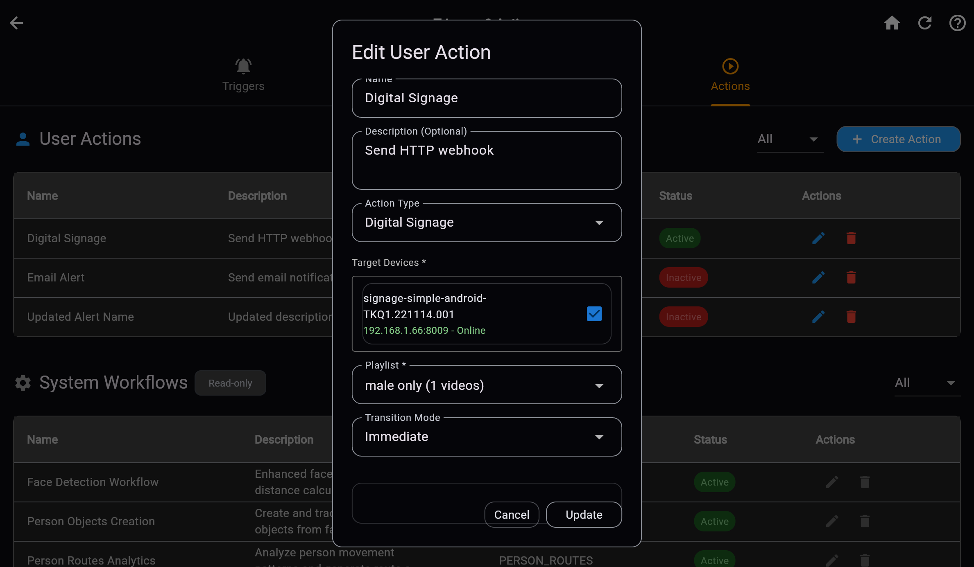
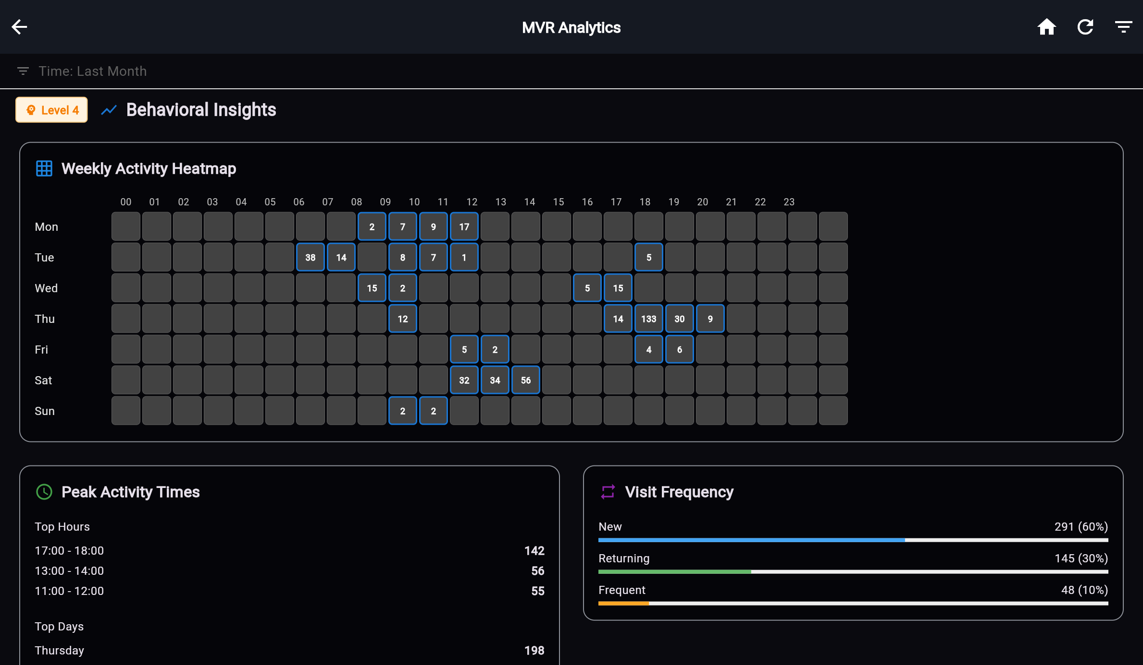
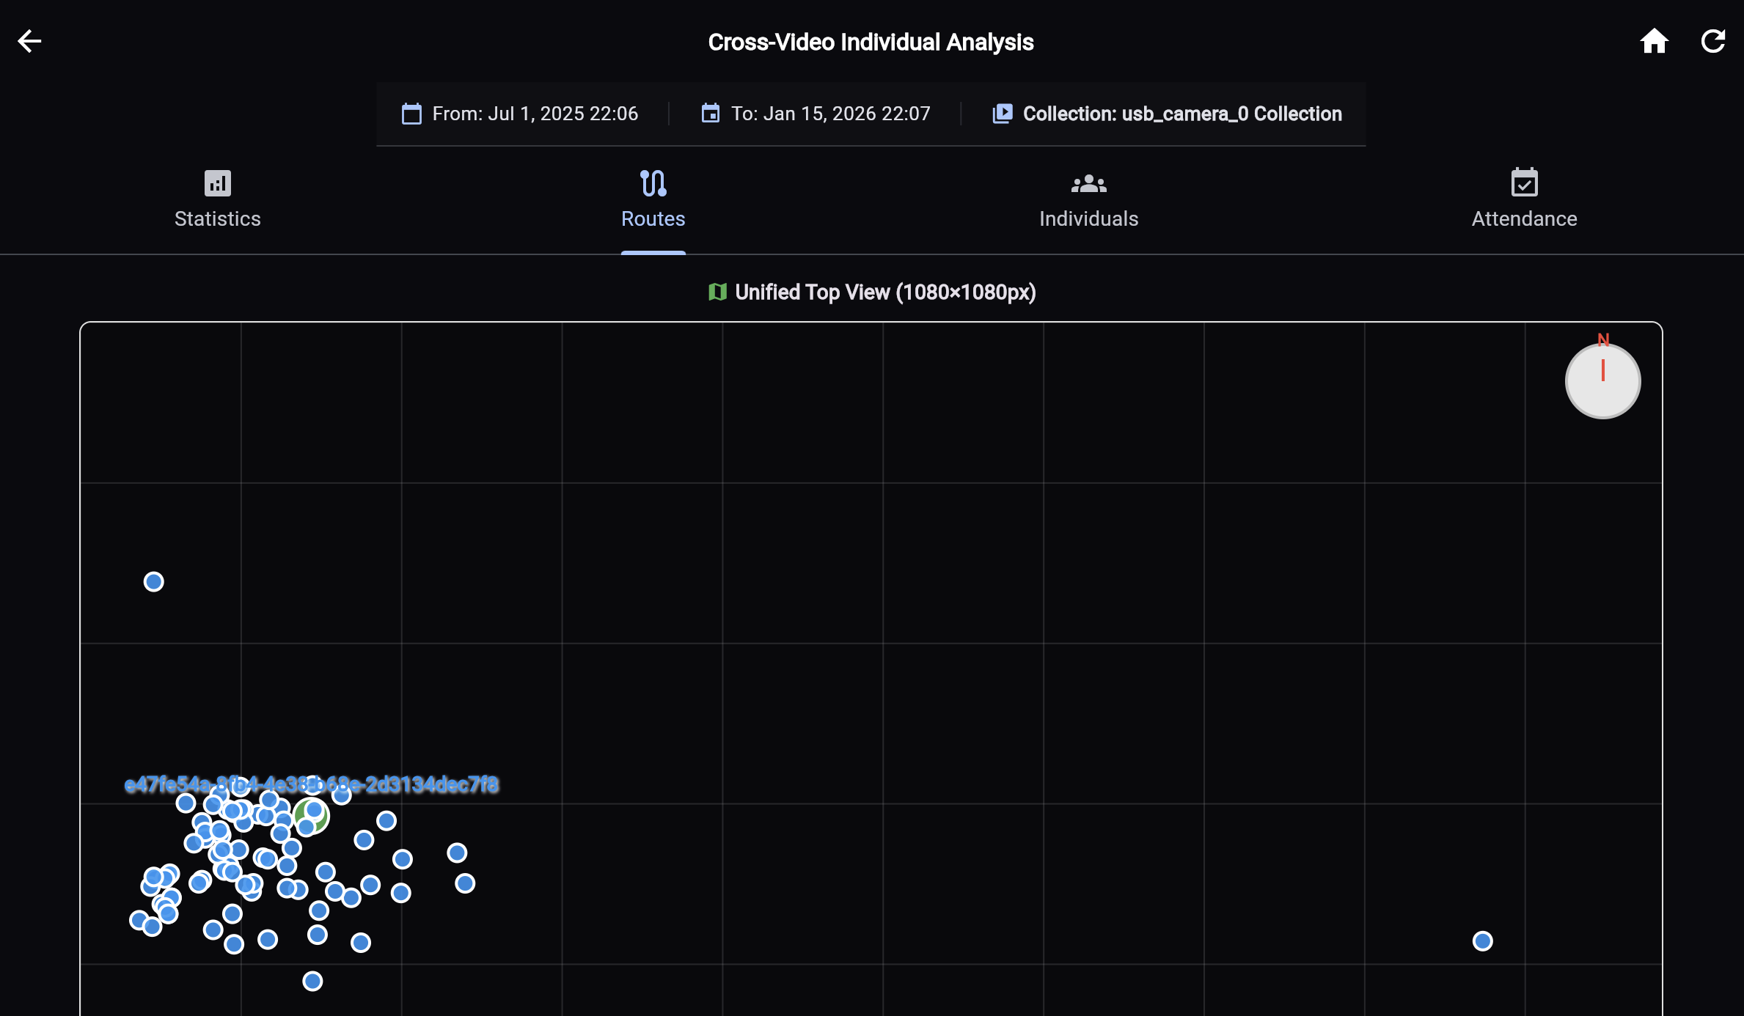
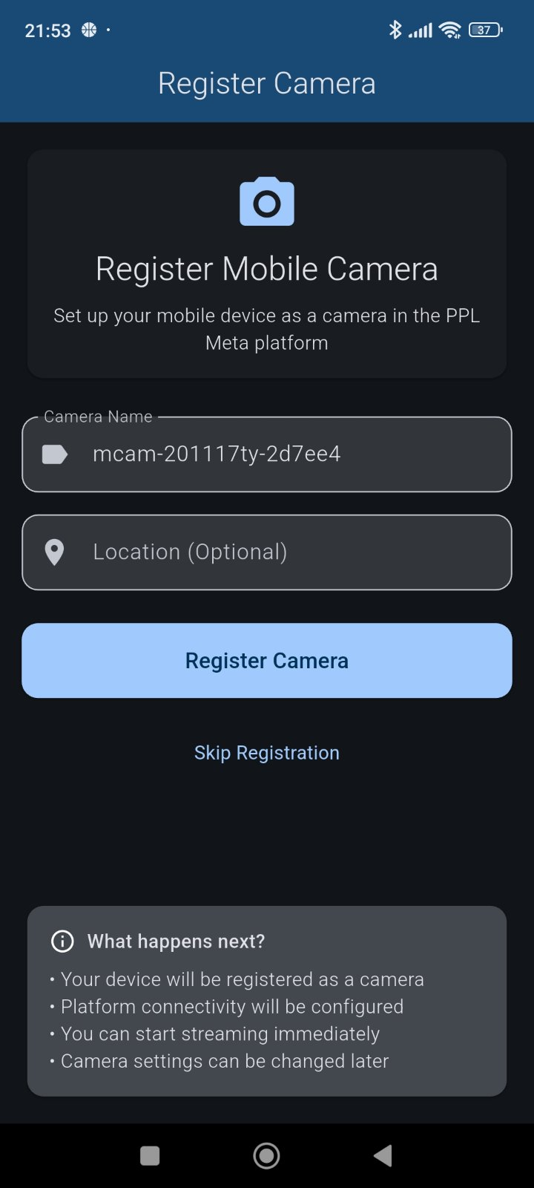
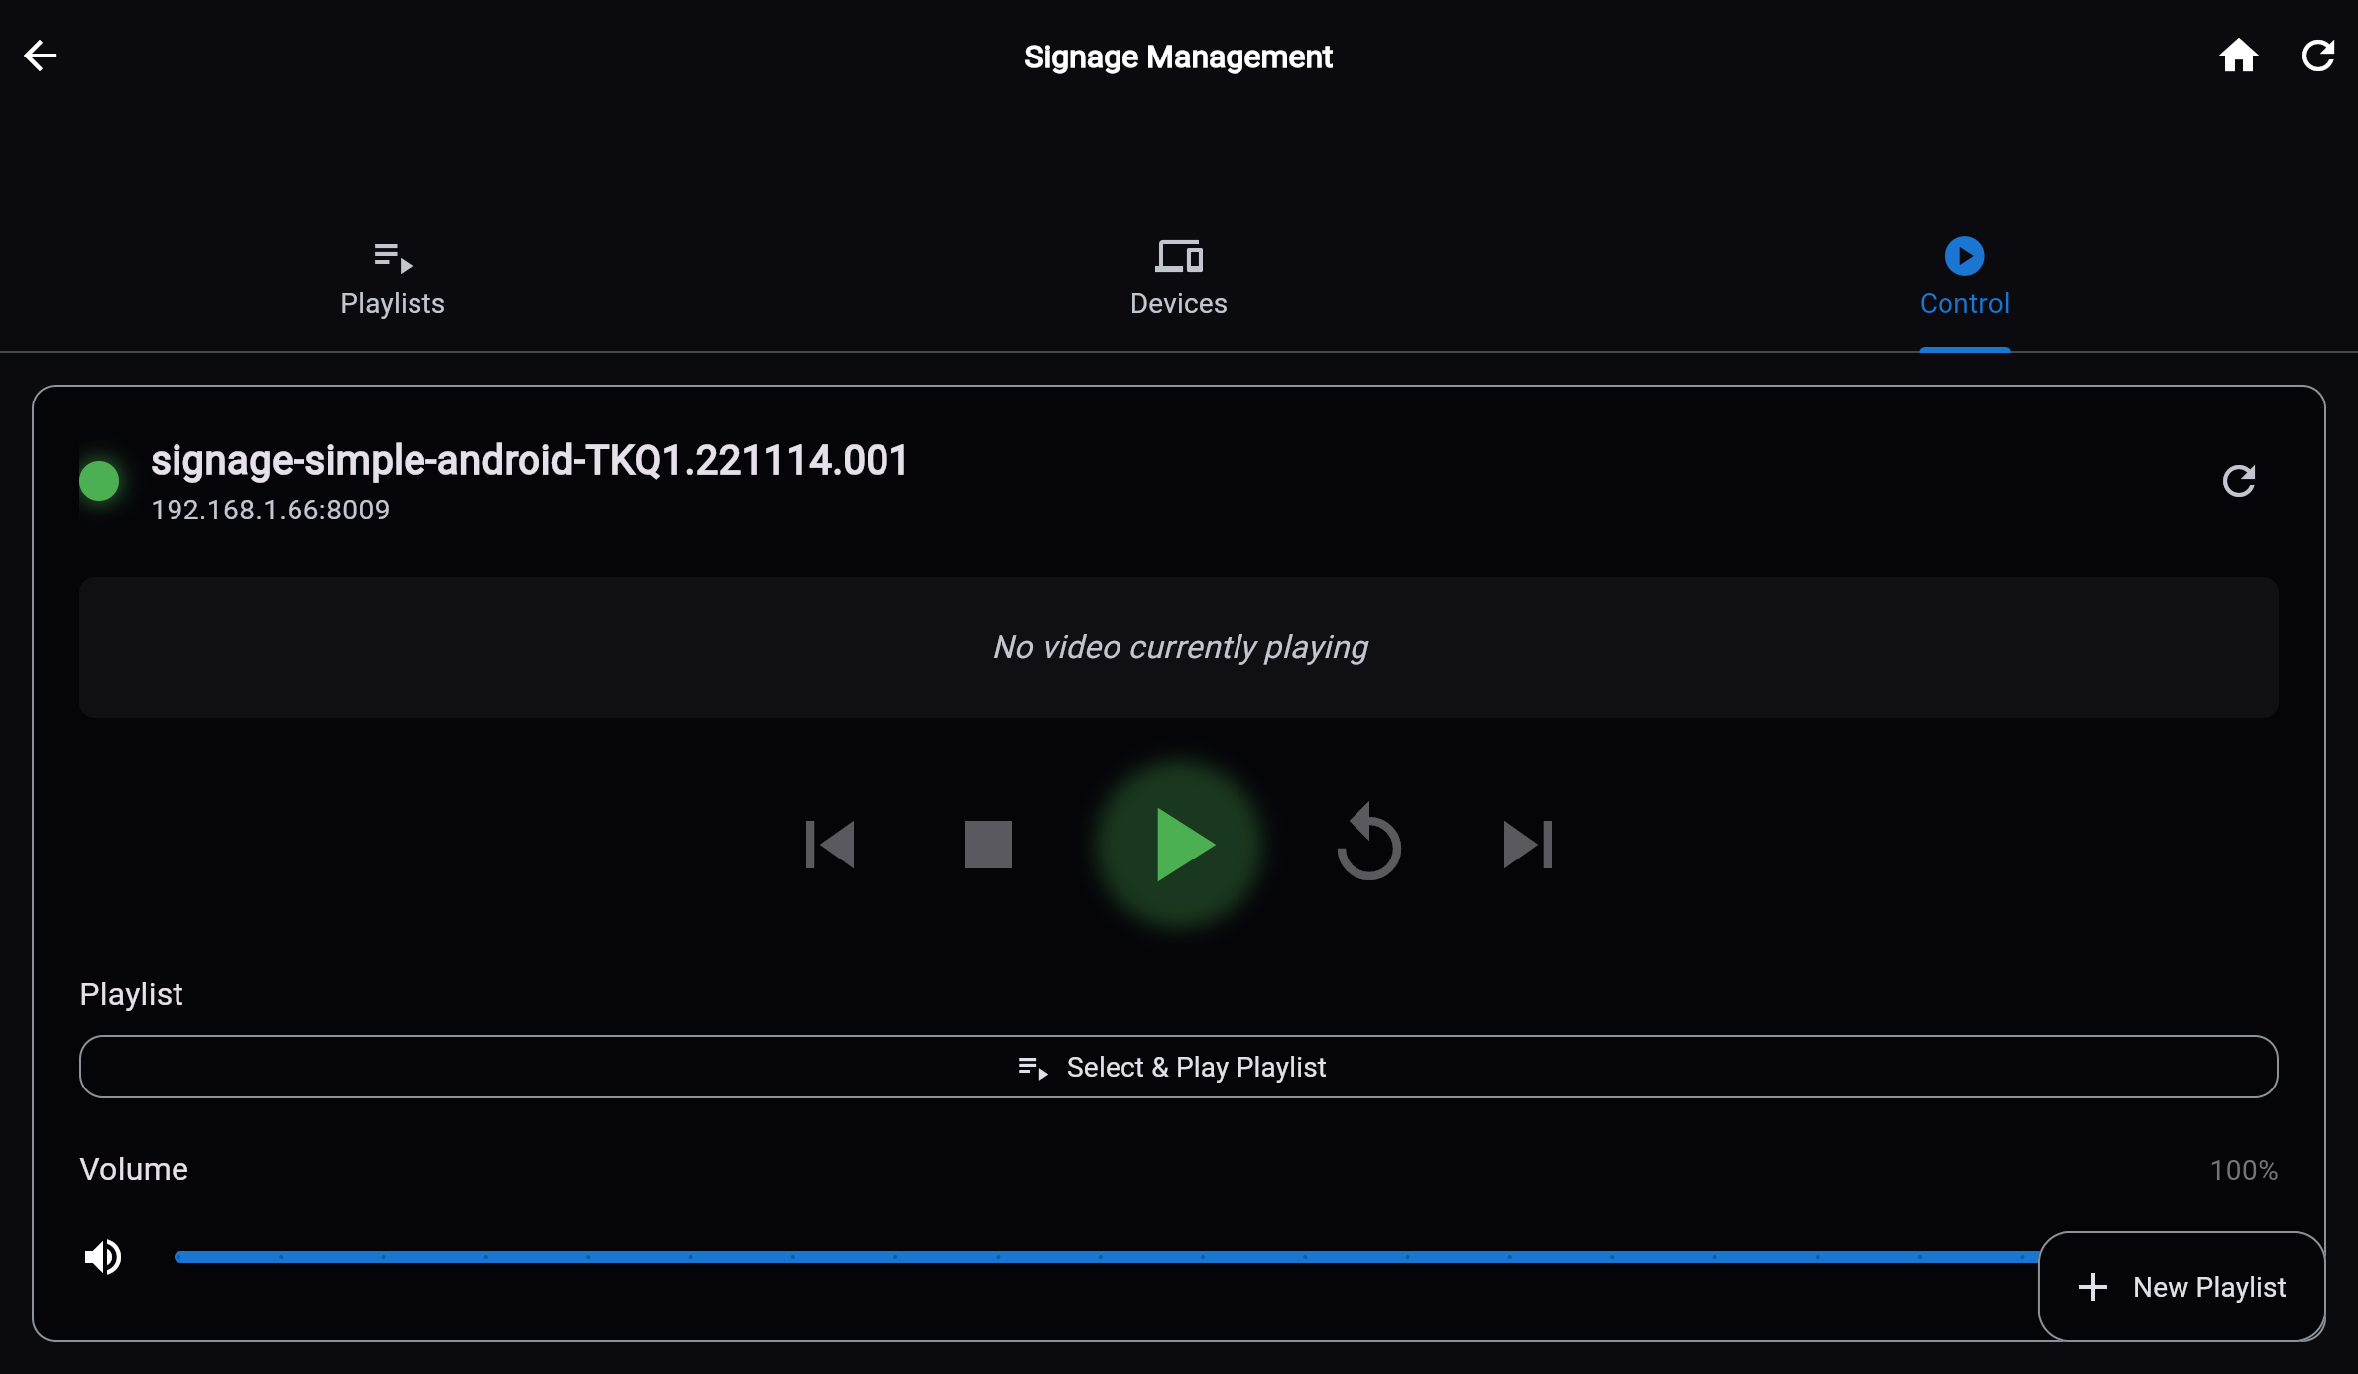
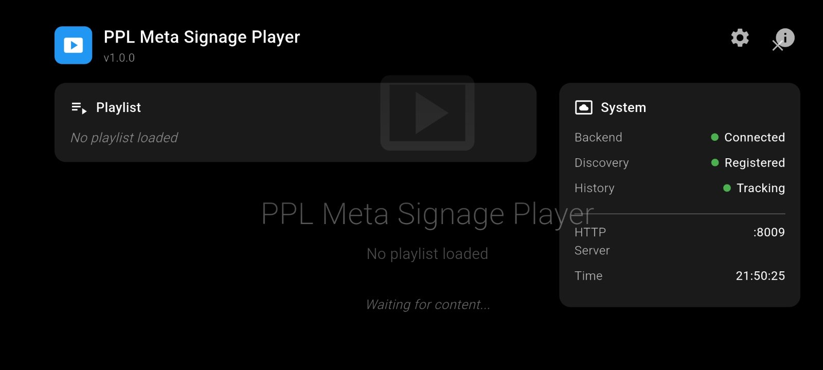
Visual Gallery — AI Concept Frames
Representative persona visuals for Slides 2-9
Actions Edit
Anaytics 02
Camera Analytics 08
Digital Signage 01
Signage Android App
Soft Camera 01
Eyenet Vision | Technology Retail Pitch

